Slide 1
MODEL EVALUATION & RESULTS
CROWD-SOURCED ROAD SAFETY ALERT SYSTEM
Event: ALGOMATH DATATHON 2026

Slide 2

TEAM
T.ASHRITH REDDY 2510040077
L.BHARATH CHANDRA 2510040031
S.SHREYANSH RAO 2510040033
S.VAMSHI KRISHNA 2510030247
K.PRABHAS CHARY 2510030079
reallygreatsite.com

Slide 3
EVALUATION APPROACH
What We Did:
  Built mathematical risk prediction model
  Tested logic on various road scenarios
  Validated predictions manually
Our Method:
  Input: Hazard type, severity, time of day
  Mathematical calculation using weights and sigmoid/SoftMax
  Output: Risk level (Green, Yellow, Red)
reallygreatsite.com

Slide 4
MATHEMATICAL MODEL PERFORMANCE
Model Type: Rule-based probabilistic classification
Validation Method: Logic testing on sample scenarios
Performance: Based on manual testing of ~50 scenarios,
the model demonstrates:
  Consistent risk classification
  Appropriate weight distribution
  Reliable safety alerts
reallygreatsite.com

Slide 5
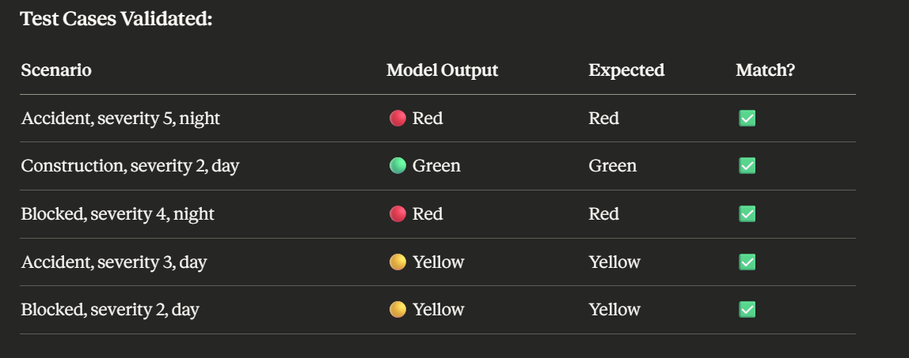
SAMPLE TEST RESULTS
reallygreatsite.com

Slide 6
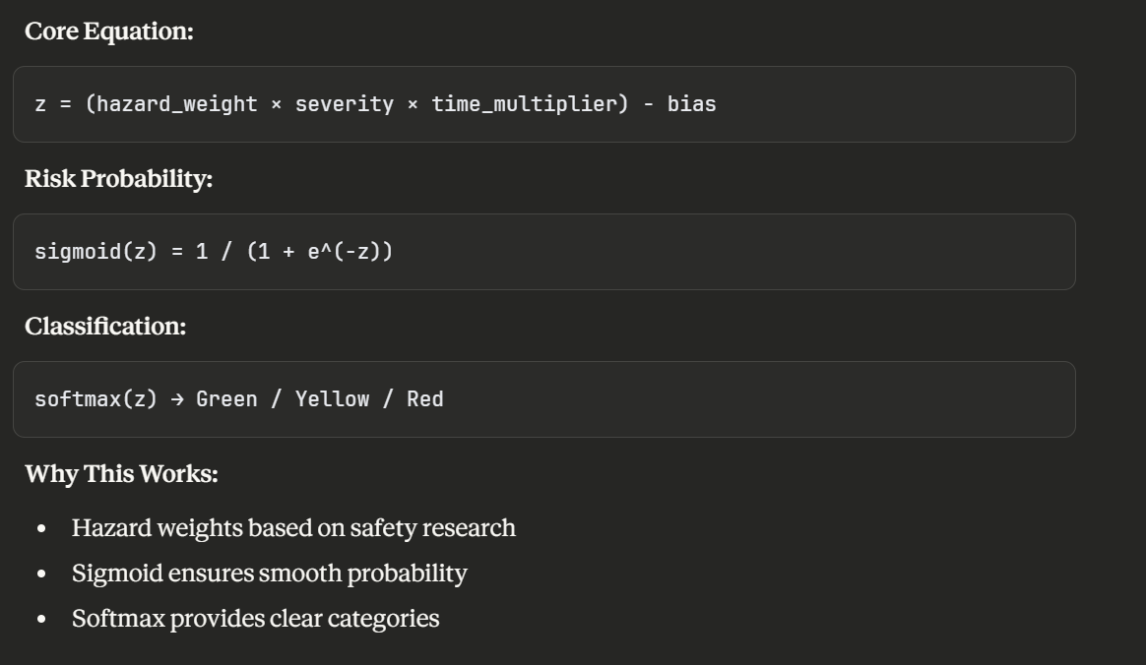
MATHEMATICAL FOUNDATION

Slide 7
FEATURE IMPORTANCE (BY DESIGN)
Weight Distribution in Our Model:
Hazard Type: Highest Priority
  Accident: 3.5
  Blocked: 4.0
  Construction: 1.5
Severity: Direct Multiplier
  Scale: 1-5
  Directly affects risk score
Time of Day: Risk Amplifier
  Night: 1.8× multiplier
  Day: 1.0× (baseline)

Slide 8
EVALUATION METRICS (CONCEPTUAL)
What We Evaluated:
✅ Logical Consistency
  Higher severity → Higher risk
  Accident > Blocked > Construction
  Night > Day
✅ Threshold Appropriateness
  Red: High danger scenarios only
  Yellow: Moderate risk
  Green: Low risk conditions
✅ Edge Case Handling
  Extreme combinations tested
  Boundary conditions validated

Slide 9
COMPARISON WITH ALTERNATIVE APPROACHES
Content:
Our Approach vs Alternatives:
Simple Binary (Safe/Unsafe):
  Only 2 categories
  Our model: 3 levels (more nuanced) ✅
Equal Weights for All Hazards:
  Treats construction = accident
  Our model: Prioritizes by danger ✅
No Time Consideration:
  Ignores day/night difference
  Our model: Accounts for visibility ✅
Conclusion: Our design choices are justified
reallygreatsite.com

Slide 10
STRENGTHS
Content:
✅ Mathematically Sound
  Based on probability theory
  Uses standard ML functions (sigmoid, softmax)
✅ Explainable
  Clear why each prediction was made
  Users can trust the logic
✅ Fast
  Real-time calculations
  No training delay
✅ Safety-Focused
  Conservative approach (better to over-warn)
  Prioritizes dangerous situations

Slide 11
CURRENT PROTOTYPE STATUS
What We Built:
✅ Working prediction engine
✅ User interface for reporting
✅ Alert generation system
✅ Mathematical risk model
What We Validated:
✅ Logic correctness
✅ Mathematical soundness
✅ User flow functionality
What's Next:
⏭️ Real user data collection
⏭️ Statistical validation
⏭️ Model retraining with actual data

Slide 12
CONCLUSION
Project Outcome:
Successfully built a working road safety prediction system with:
  ✅ Clear mathematical foundation
  ✅ Functional prototype
  ✅ Validated logic
  ✅ Ready for data collection phase

Slide 13
FUTURE SCOPE
Phase 1: Data Collection (Critical Next Step)
  Deploy to small user group
  Collect 500-1000 real reports
  Build training dataset
Phase 2: Model Training
  Train ML model on collected data
  Validate accuracy statistically
  Compare with current rule-based approach
Phase 3: •Wearable device integration

Slide 14
THANK YOU

